Slide 1

Customer Data Science
Stand-up Updates
July 14, 2017

Slide 2




Key updates
Discount Sensitivity model Scoring - BR
Clickstream Analysis Gen 2 - BR
Domino Platform exploration
Exploratory Analysis on Causal Modeling
Email Model Optimization
Gap Inc Confidential – Do Not Distribute or Copy Without Authorization

Slide 3
Email model optimization
july 2017
PLATFORM ANALYTICS

Slide 4

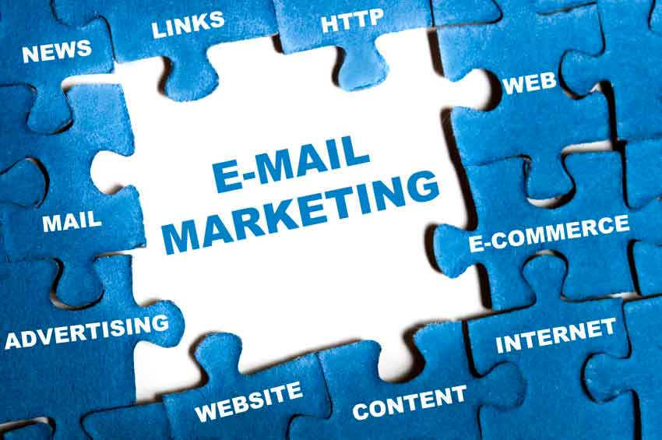
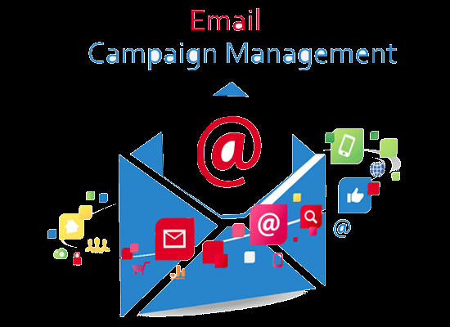
BACKGROUND
Business Objective
Scope
Solve for the best use of two of following models during email campaign so that we get best of customer click/browse engagement and multichannel purchase rate.
Email Engagement Response Model:
This quantifies the propensity of a customer opening or clicking a marketing email.
Channel Agnostic/Multichannel Response Model - Probability of a customer making a purchase in store or online after receiving an email campaign within 2 days
Brand - GP
Market - US
Outcome
The Email Marketing Team wants a statistically/mathematically rigid way of optimizing above two models at the same time. The team would like to use this approach for finding best customer subset for campaign communications.

Slide 5
METHODOLOGY
We have used past campaign performance and analyzed different scores and actual responses. Empirically use different linear combination of score which maximizes responder separation in top deciles
The following campaigns were used to train the Email Models.
Campaign Circulation Event Date
2033109 8,648,234 5/28/2017
2034203 8,689,400 5/29/2017
Definition of Multichannel Response and Email Engagement:
Multichannel Response: A customer makes a purchase within 2 days after receiving an email campaign will be tagged as a response. A store purchase or an online purchase will qualify as multichannel response.
Email Engagement Response: A customer opens a marketing email or clicks on an email and navigates to our site, it will qualify as email engagement response.
Data Preparation, Model optimization:
1. Customer level data along with campaign related details aggregation from MDS tables in HDP 1.3 using Hive.
2. Exporting HDFS tables to edge node and downloading them to local shared drives.
3. Appending the data from all the campaign versions in R.
4. Exploratory Data Analysis in R.
5. Evaluating the different ensembles levels based on simulation run and test their performance based on factual response
6. Use the selected criteria for optimization based on multiple factors of model validations

Slide 6
RESULTS
Key Evaluation Metrics :
1. ROC Curve and Area under the ROC Curve
2. Cumulative Gains Chart
3. Cumulative Lift Chart
4. Response Rate Waterfall
Outputs
https://mithunghosh.shinyapps.io/Score_ensemble_summary_2034203/
https://mithunghosh.shinyapps.io/score_ensemble_summary_2033109/
Decision
50% and 50% weightage for multichannel and email response score respectively has been decided for this month’s campaign run

Slide 7
Click stream analysis – gen 2
July 2017
PLATFORM ANALYTICS

Slide 8
BACKGROUND
Business Objectives :
Dataset Used for the analysis :
To be able to understand various customer browse types
Identify the typical customer journey while browsing at BR website
Ability to proactively segment customers at early stage of browse
Understanding of browsing segment will enable in strategizing web marketing
Brand – BR
Market – US
Month - April 2017
Total Browse in a Month
9,845,163
Analytical Approach:
Sample of Raw session for Analysis
1,958,749
Group the browse sessions based on their length
Run clustering on each of the group as below
Removal of bounce sessions and sessions i.e. <=2 clicks
650,687
Browse Group | # Sessions | % Sessions
1-8 Clicks | 459,052 | 71.86%
9 -18 Clicks | 116,912 | 18.30%
19-27 Clicks | 31,400 | 4.92%
28-35 Clicks | 14,122 | 2.21%
36- 45 Clicks | 10,372 | 1.62%
46-57 Clicks | 6,966 | 1.09%
Total | 638,824 | 100.00%
Removal bot sessions i.e. > 57 Clicks
638,824
Among 9.8M monthly browse session 638k have been used for session clustering

Slide 9
Thank you

